Slide 1
Newest Invention … Will we still use them in the next century?
Ta’Naizha Willis
December 17,2013

Slide 2
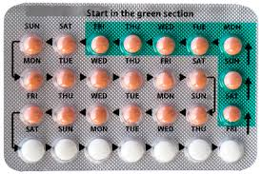
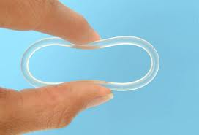
Birth Control .. A Good Invention!
Birth Control was invented in 1950. Birth control, is an invention that will be used in the next 100 years. Birth control, is a pill or a product that prevents pregnancy between teens and adult women. I think birth control will be used in the next 100 years is because it will stop a lot of pregnancy and teen pregnancy the most. Teenagers now a days are getting pregnant faster than adults, and birth control will prevent that.

Slide 3
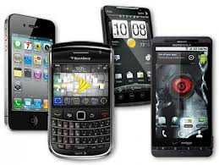
Smart Phones!
Smart phones are one of the best inventions to be invented! Will they be used in the next hundred years? Yes. They will be used in the next 100 years because of the technology built inside of it and because of the wonderful things it could do. If you don’t have a portable GPS, you can look in your smart phone and get directions to your destination. Adults can track their kids, use the internet if they dint have a computer or if they need the internet at a random time. Smart phones was a good invention, and will be used in the future.

Slide 4
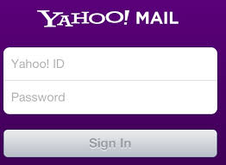
Email ! Email! Email!
Email is one the best inventions that was created. Emails will be used in the next 100 years for sure! Email were created for many different things. You can contact your family, if you dint have a phone. You can contact your boss for any reason. It was created for communication. There are different types of email. You can use Yahoo, Gmail, Hotmail and Aol. Kids, adults, and seniors can use emails for anything.

Slide 5
CITATIONS!!!
http://bedsider.org/where_to_get_it
http://www.webmd.com/sex/birth-control/
http://en.wikipedia.org/wiki/Smartphone
http://en.wikipedia.org/wiki/Email

